Slide 1
American Sign Language detection
using Multi Modal CNN

Slide 2
Group member Information
ANISH KOPPULA (700759641)
SAI NALLA (700763475)
BALA RISHIK MARNENI (700746746)
DEEKSHITHA GADDAMEDHI (700755765)

Slide 3
Role/Responsibilities and Contribution in project
Name | Role | Responsibilities | Contributions
Bala Rishik Marneni | Project Manager | Setting project goals and timelines | Facilitated communication among team members coordinating tasks, and ensuring project milestones were met
Anish Koppula | Data Collection Specialist | Collecting multi-modal ASL dataset, including image and depth sensor data | Collected and preprocessed multi-modal ASL dataset, ensuring data quality and consistency. Implemented data augmentation techniques to increase the diversity of the dataset
Deekshitha Gaddamedhi | Multi-Modal CNN Model Developer | Designing and developing multi-modal CNN architectures for ASL recognition | Developed multi-modal CNN architectures for ASL recognition. Trained and optimized the models for maximum performance.
Sai Nalla | Model Evaluator and Performance Analyst | Evaluating the performance of multi-modal CNN models on the test dataset. | Analyzing metrics such as accuracy, precision, recall, and F1-score.

Slide 4
Motivation
Sign languages play a crucial role in facilitating communication within the deaf community. However, the intricate nature of sign language gestures poses significant challenges to accurate recognition and interpretation. Depending on RGB images will not capture those intricacies. Recognizing these challenges, our research is motivated by the need to address them effectively. We aim to propose a novel approach to sign language recognition by leveraging Multimodal Convolutional Neural Network (CNN) architecture. By integrating both color (RGB) and depth information, our goal is to enhance the accuracy and robustness of sign language recognition systems.

Slide 5
Objectives
Enhancing Classification Accuracy: The primary objective is to improve the accuracy of sign language gesture classification compared to existing models.
Utilizing Multi-Modal Information: Another objective is effectively utilizing information from multiple modalities (RGB and depth) to capture the nuances of sign language gestures.
Data gathering: In the data gathering step in addition to the ready-to-use parameters new parameters are also used to check the model performance and their importance in the prediction of attrition the features are: previous work experience, the reason for leaving, and previous company salary.Data preparation: Collected raw data is cleaned and prepared to match the requirements of the predictive models
Promoting Accessibility: A broader objective may involve promoting accessibility and inclusion for the deaf community. By developing a robust prediction system.
Scalability and Generalization: Another aim could be to design a model that is scalable and generalizable

Slide 6
Related work
This article addresses the challenge of developing a high-quality sign language dataset for Thai fingerspelling. The researchers gathered information from 43 individuals with varied backgrounds, genders, and physical characteristics of 24 fundamental Thai fingerspelling signs. To tackle this challenge, the study explores six deep learning architectures: RGB-sequencing-based CNN LSTM and VGG-LSTM, LSTM, BiLSTM, and GRU ST-GCN model. The article investigates individual modalities as well as their combinations. The findings indicate that combining the RGB-sequencing modality from VGG-LSTM achieved the highest performance [1].
Indian Sign Language (ISL) is commonly used in India. Nowadays, online interpreters are available, but they often require experts for translation, making them uneconomical at times. Therefore, this work focuses on a vision-based fingerspelling system using Convolutional Neural Networks (CNNs). The proposed CNN model performs well with InceptionV3 and outperforms existing models such as ResNet and VGG16 [2].
This project focuses on real-time recognition of American Sign Language (ASL) finger-spelling, utilizing a Deep Convolutional Neural Network (CNN) for classification. The aim is to facilitate communication between hearing-impaired individuals and the general population. The dataset consists of over 50,000 images covering the ASL alphabet (A to Z) and numerals (0 to 9), capturing the distinct characteristics and variations in hand shape and position for each sign. The proposed model achieves an accuracy of 99.70 in classification[3].

Slide 7
Problem Statement
Sign languages serve as vital communication tools for the deaf community, relying on visual and manual expressions when verbal communication is challenging. One prominent example is Indian Sign Language (ISL), utilized within educational settings to impart academic knowledge to deaf students. Sign Language plays a crucial role in fostering communication and inclusivity within the deaf community. However, sign language gestures are intricate, involving intricate hand shapes and movements that RGB images alone may not fully capture. This limitation can hinder accurate recognition and interpretation, particularly when gestures bear resemblance to one another.

Slide 8
Proposed Solution
In this paper, we are proposing a Multi-Modal Convolutional Neural Network(CNN) which takes the color and depth as input. Depth information, on the other hand, offers valuable insights into the spatial relationships among various hand components and between the hand and surrounding elements.This architecture improves the classification accuracy compared to the existing models. The model achieved 75 percent accuracy.

Slide 9
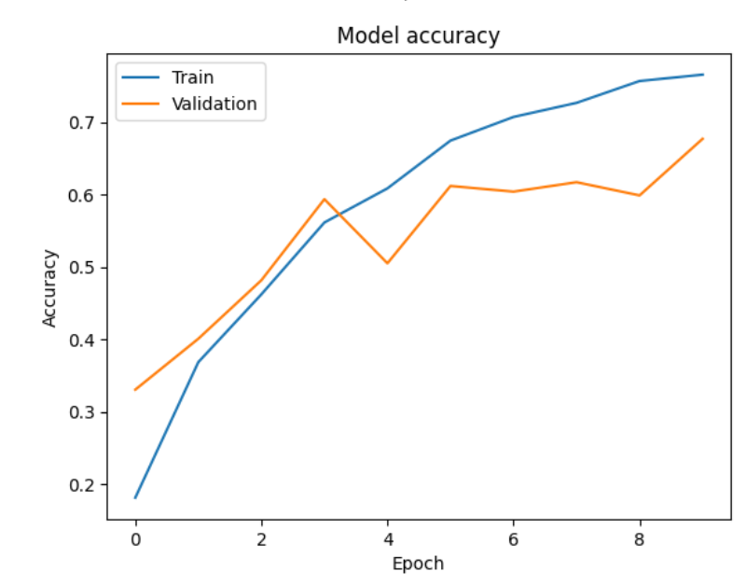
Results/Simulations
Figure.1. Represents the accuracy plot of Multi modal CNN model.
The model achieved 75 % accuracy.
This accuracy is for 10 epochs on sample data of ASL alphabets.
Figure.1. Model accuracy plot

Slide 10
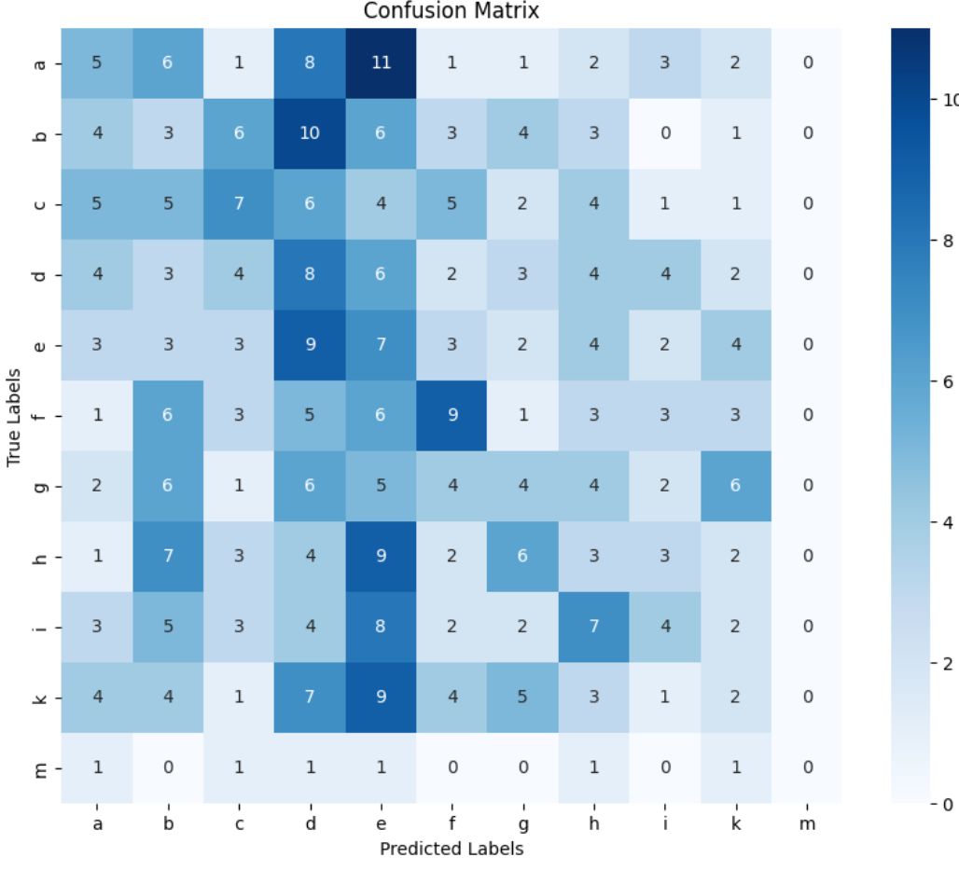
Results and simulations
Figure.2 represents the confusion matrix
Figure.2.Confusion matrix

Slide 11
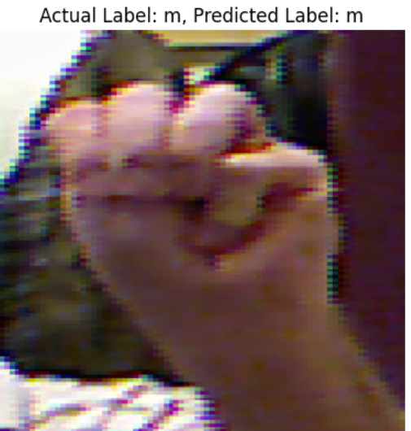
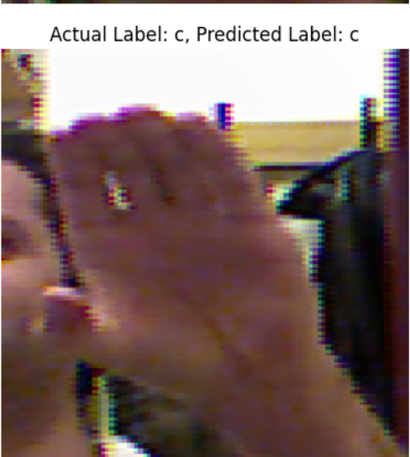
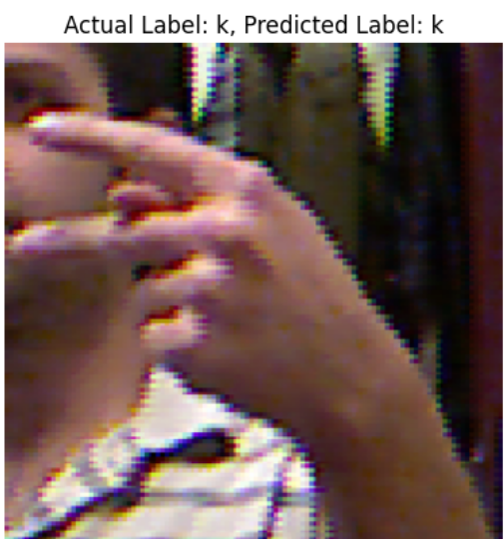
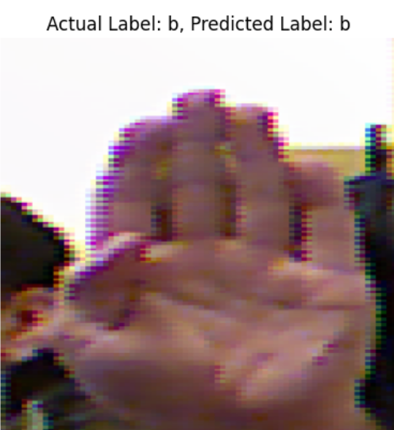
Results and simulations
Figure.3 represents the sample predictions by the saved model of Multi Modal CNN
Figure.3 .Sample predictions

Slide 12
References
[1].W. Vijitkunsawat, T. Racharak and M. L. Nguyen, "Deep Multimodal-based Number Finger Spelling Recognizer for Thai Sign Language," 2023 22nd International Symposium on Communications and Information Technologies (ISCIT), Sydney, Australia, 2023, pp. 99-104, doi: 10.1109/ISCIT57293.2023.10376072. keywords: {Visualization;Fingers;Gesture recognition;Auditory system;Assistive technologies;Skeleton;Information and communication technology;Thai Number Finger Spelling;Sign Language Recognition;Benchmark Dataset},
[2].C. Raghavachari and G. Shanmugha Sundaram, "Deep Learning Framework for Fingerspelling System using CNN," 2020 International Conference on Communication and Signal Processing (ICCSP), Chennai, India, 2020, pp. 469-473, doi: 10.1109/ICCSP48568.2020.9182155. keywords: {Assistive technology;Machine learning;Gesture recognition;Convolution;Training;Kernel;Standards;Convolutional Neural Networks;Fingerspelling;Hand Gesture Recognition;Inception V3;ResNet and VGG16},
[3].A. Howal, A. Golapkar, Y. Khan, S. Bokade, S. Varma and M. V. Vyawahare, "Sign Language Finger-Spelling Recognition System Using Deep Convolutional Neural Network," 2023 5th Biennial International Conference on Nascent Technologies in Engineering (ICNTE), Navi Mumbai, India, 2023, pp. 1-6, doi: 10.1109/ICNTE56631.2023.10146675. keywords: {Training;Image resolution;Shape;Face recognition;Symbols;Gesture recognition;Auditory system},

